Slide 1
B02 - Fundamentals of the ForNAV Designer

Slide 2
Program
How to create a new report
Create a Customer top 10 report from scratch
Looking back

Slide 3
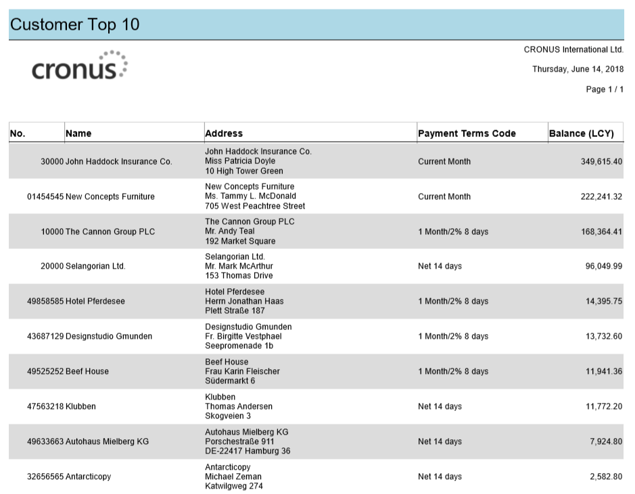
Preparation

Slide 4
Preparation
Steps to create a new report:
Select a list template;
Create reports from the ForNAV designer and save it in NAV;
Edit a report and preview it;
Add fields in a table;
Use Captions, Field Groups, and Field Lookups;
Sorting and filtering.

Slide 5

Execution

Slide 6
Reflection
Look at the report and its Dataset in C/Side
Look at the ReportForNav functions in C/Side.

